Slide 1
NexED
University Management System
Team:
Amal Roy
Angela Mathew
Arya Anil Kumar
Nidhin Manoj
Saranya V A

Slide 2
Introduction
Here we are introducing a web application- (NexED) which is a University Management System integrating Administrative , Academic and Student services.
This can be used by universities for seamless hasslefree communications and operations within a single platform.

Slide 3

Outline:
● Problem Statement
● Objective
● Project Overview
● Onboarding-Architecture
● Project Flow
● Technology and Tools Used
● Conclusion

Slide 4
Problem Statement
The lack of an integrated Edutech Management Platform hampers productivity in administrative, academic, and student service operations.
Requirement for a centralized software solution to streamline
student information management
faculty/staff, administration
class/curriculum oversight
for schools/universities, ensuring seamless operations and enhanced decision-making capabilities.

Slide 5
Objective
To develop a centralized software solution to streamline
student information management
faculty/staff administration
class/curriculum oversight
student performance report
for ensuring seamless operations and enhanced decision-making capabilities.

Slide 6

Project Overview
TEACHER
LOGIN
API
HOME
STUDENT
REGISTER
SQL
ADMIN

Slide 7
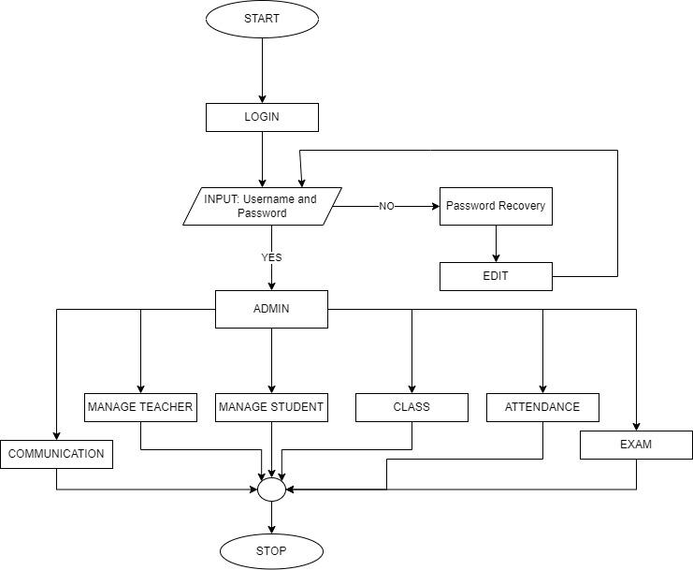
Project Flow
Admin >>

Slide 8
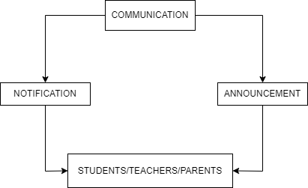
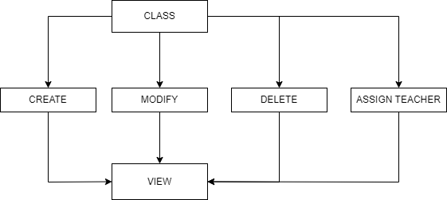
Communication
>>
Admin
Class >>
Admin

Slide 9
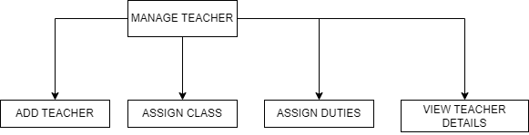
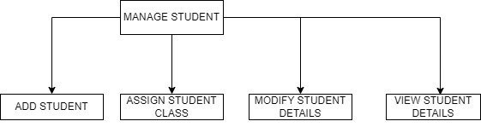
Manage Teacher >>
Admin
Manage Student >>
Admin

Slide 10
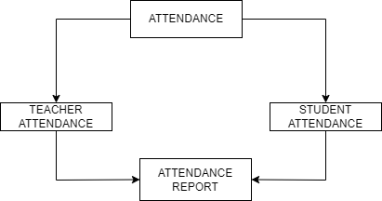
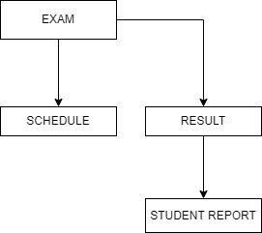
Attendance
>>
Admin
Examination
>>
Admin

Slide 11
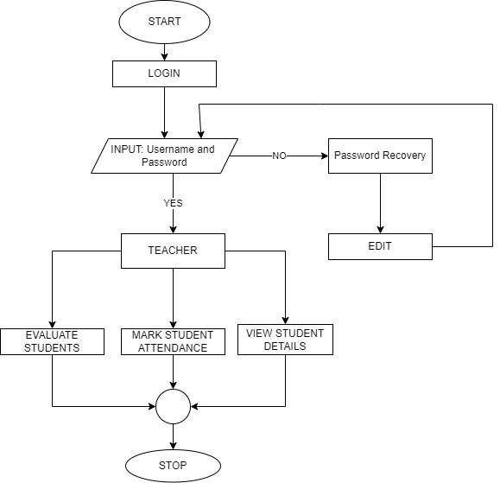
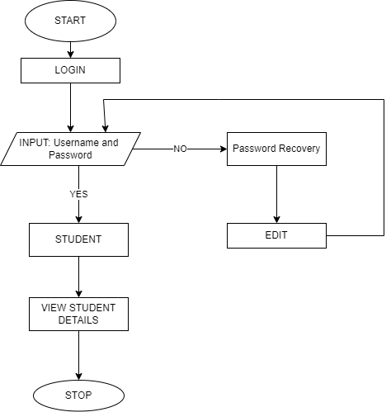
Student >>
<<Teacher

Slide 12
Architecture
API
FRONT-END
{REACT}
API
SQL SERVER
(GET/ PUT/ POST)
(GET/DELETE)
(VALIDATE)

Slide 13






Technologies Used

Slide 14

Conclusion
Based on our understanding of the problem statement we have brainstormed and designed a centralized web application to ensure a seamless operation among users that would facilitate timely organisation and easy flow among users.

Slide 15


Slide 16

Any Questions

